Slide 1
ER Diagrams (Conceptual, Logical)
Team 2: UnitFit

Slide 2
Team 2: UnitFit
ER Diagram (Conceptual)
User ID
Phone number
calories
Email
Name
FName
consult
Customer
Recipe
LName
image
User ID
Password
use
click
image
content
Ads and Promo
Dashboard
User ID
Tracking weight
Ad’s ID
link
Tracking Calories
Calendar Tracking
Tracking Workouts
Tracking Time

Slide 3
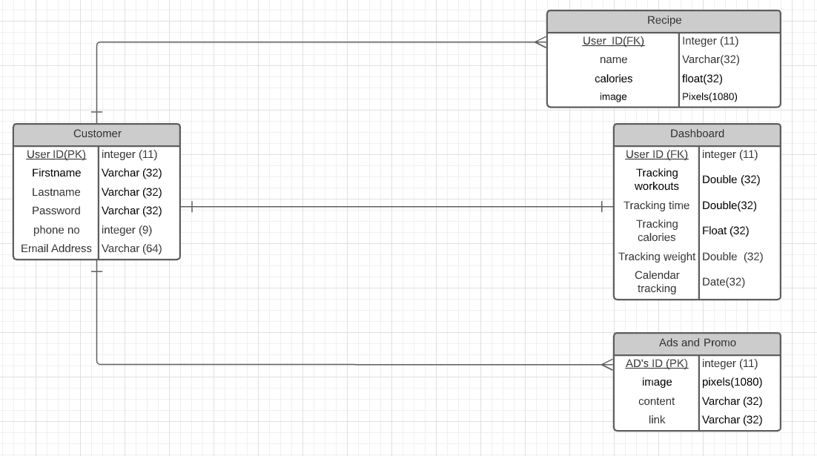
Logical ER diagram
ER Diagram (Logical)

